Slide 1
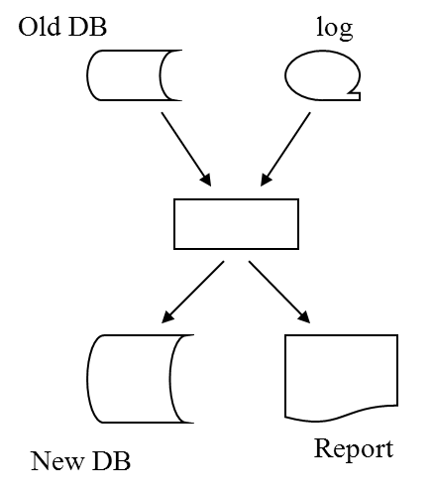
Unit 12 Database Recovery

Slide 2
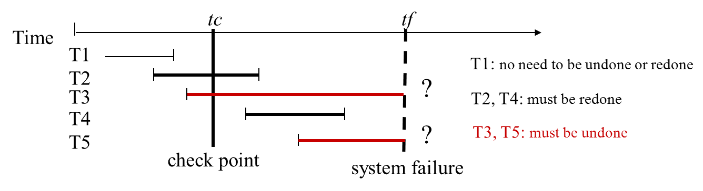
Contents
12.1 Introduction
12.2 Transactions
12.3 Transaction Failures and Recovery
12.4 System Failures and Recovery
12.5 Media Failures and Recovery

Slide 3
12.1 Introduction

Slide 4
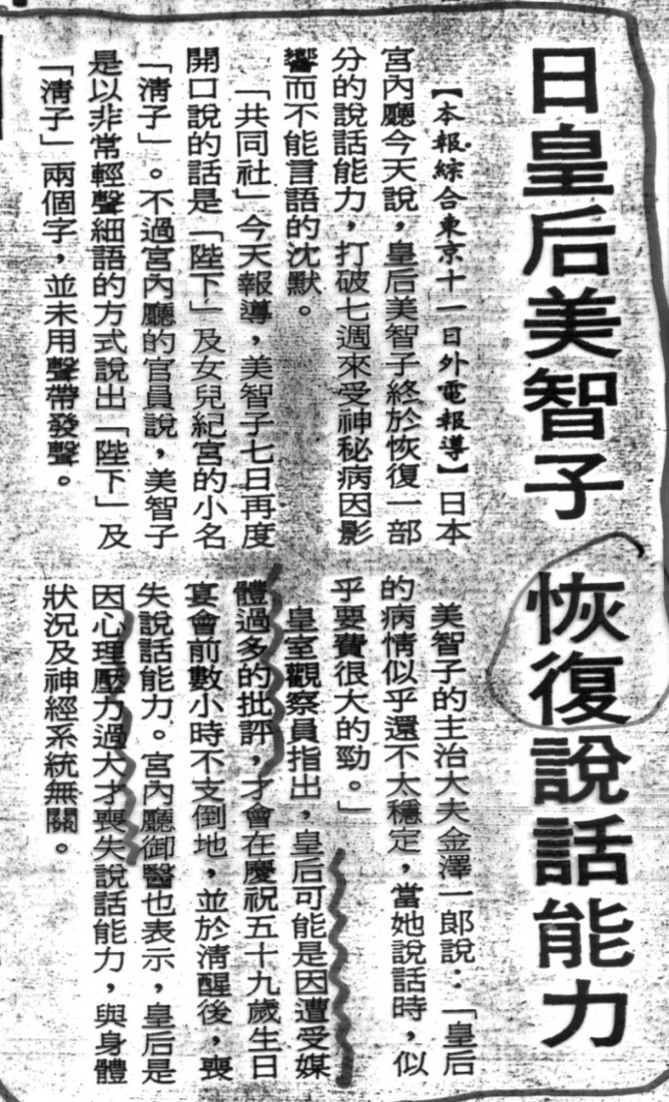
Database Recovery: Introduction
The Problem of Database Recovery
To restore the database to a state that is known to be correct after some failures.
Possible Failures
programming errors, e.g. divide by 0, QTY < 0
hardware errors, e.g. disk crashed
operator errors, e.g. mounting a wrong tape
power supply, fire, ...
Principle of Recovery: Backup is necessary

Slide 5
Database Recovery (cont.)
Basic approach
1. Dump database periodically.
2. Write a log record for every change. e.g. E#, old_value, new_value, …
3. If a failure occurs:
CASE1 : DB is damaged ==> archive copy + redo log = current DB.
CASE2 : DB is not damaged but contents unreliable ==> undo some log.
8:00
update
log
10:00
8:00 -10:00

Slide 6
12.2 Transactions
unit of Work
unit of Recovery
unit of Concurrency (Unit 13)

Slide 7
Transactions: Concepts
A logical unit of work.
Atomic from the point of view of the end-user.
An all-or-nothing proposition.
<e.g.>
TRANSFER : PROC; /* transfer account */
GET (FROM, TO, AMOUNT);
FIND UNIQUE (ACCOUNT WHERE ACC#=FROM);
ASSIGN (BALANCE - AMOUNT) TO BALANCE;
IF BALANCE < 0
THEN DO; PUT ( 'INSUFFICIENCY FUNDS'); ROLLBACK; END;
ELSE
DO; FIND UNIQUE (ACCOUNT WHERE ACC# = TO); ASSIGN (BALANCE + AMOUNT) TO BALANCE; PUT ('TRANSFER COMPLETE' ); COMMIT;
END;
END;

Slide 8
Transactions: Example
<e.g.> [CASCADE CHANGE ON S.S# TO SP.S#]
CHANGE: PROC OPTIONS (MAIN)
EXEC SQL WHENEVER SQLERROR GOTO UNDO;
GET LIST (SX, SY);
(i) EXEC SQL UPDATE S
SET S# =: SY;
WHERE S# =:SX;
(ii) EXEC SQL UPDATE SP
SET S# =: SY;
WHERE S# =: SX;
EXEC SQL COMMIT;
GO TO FINISH;
UNDO: EXEC SQL ROLLBACK;
FINISH: RETURN;
END
S
S#
S1
S001
SP
S#
S1
S001

Slide 9
Transactions: Structure
Structure of a Transaction
BEGIN TRANSACTION;
/* application specified sequence of operations*/
.
.
COMMIT; /* signal successful termination */
(or ROLLBACK; /* signal unsuccessful termination*/)
Implicit BEGIN TRANSACTION, COMMIT, ROLLBACK may be implicit:
Program initiation BEGIN TRANSACTION
Normal termination COMMIT
Abnormal termination ROLLBACK
Program and Transaction: one program may contain several transactions.
Time
Tx1
Tx2
Tx3
program
initiation
ROLLBACK
program
termination
COMMIT
BEGIN
TRANSACTION
BEGIN
TRANSACTION
COMMIT
BEGIN
TRANSACTION

Slide 10
Transactions: Manager
Transaction cannot be nested:
Transaction Manager: Transaction should not be lost, or partially done, or done more than once <e.g.> Consider the CASCADE example, if the system crashed between two updates ==> the first update must be undone !
Time
Tx1
Tx2
BEGIN
TRANSACTION
BEGIN
TRANSACTION
COMMIT
failure
Does Tx2 need to be rolled back ?

Slide 11
Transactions: Commit and Rollback
COMMIT:
signal successful end-of-transaction.
all updates made by that transaction can now be made permanent. (e.g. buffer to disk)
ROLLBACK:
signal unsuccessful end-of-transaction.
the database may be in an inconsistent state.
all update made by that transaction so far must be 'rolled back or undone'
How to undone an update ?
system maintain a log or journal on tape or disk on which details of all update are recorded.
Begin Tx
Commit
End Tx
update
write

Slide 12
Transactions: Synchronization Point (SynchPoint)
Represents the boundary between two consecutive transactions.
Corresponds to the end of logical unit of work.
A point at which the database is in a state of consistency.
Established by COMMIT, ROLLBACK, and program initiation.
When a synchpoint is established:
All updates since the previous synchpoint are committed (COMMIT) or undone (ROLLBACK)
All database positioning is lost. (e.g. cursor).
All record locks are released.
SynchPoint
SynchPoint
SynchPoint
program
initiation
BEGIN
TRANSACTION
COMMIT
BEGIN
TRANSACTION
ROLLBACK
program
termination
.
.
.

Slide 13
Types of Transaction Failure
Type 1 Transaction Failures:
detected by the application program itself.
e.g. Insufficient Funds (balance < 0)
How to handle ?
Issue the ROLLBACK command after the detection. (ref. p.12-7)
Type2 Transaction Failures:
not explicitly handled by the application
e.g. divide by zero, arithmetic overflow, ...
System Failures (Soft crash):
affect all transactions currently in progress,
but do not damage the database. e.g. CPU failure.
Media Failures (Hard crash):
damage the database.
affect all transactions currently using that portion. e.g. disk head crash.
Application program
處理
§ 12.3
§ 12.4
§ 12.5

Slide 14
12.3 Type 2 Transaction Failures and Recovery

Slide 15
Transaction Failures and Recovery
Transaction Failures:
failures caused by unplanned, abnormal program termination.
<e.g.> arithmetic overflow
divided by zero
storage protection violation
log overflow...
How to recover transaction failures ?
System force a rollback.
the rollback is coordinated by Recovery Manager.
working backward through the log
to undo changes (replace new value by old value)
until the “BEGIN TRANSACTION” is encountered.

Slide 16
UNDO Logic and REDO Logic
UNDO Logic
=> cause the rollback procedure to be restarted from the beginning.
Idempotent Property : [Gray '78]
UNDO ( UNDO ( UNDO ( ... ( x ) ) ) = UNDO ( x ) for all x
i.e. undoing a given change any number of times is the same as undoing it exactly once.
REDO Logic REDO (REDO (REDO (...(x))) = REDO (x) for all x.
UNDO
failure
failure again

Slide 17
Log
On-line log (active log) v.s. Off-line log (archive log) :
log data: 200 million byte/day ==> infeasible to be stored entirely on-line
active log: stored on disk if full ==> dump to tape ==> archive log.
Log Compression
Archive log can be compressed => reduce storage, and then increasing efficiency
How to compress archive log ?
log records for transactions that failed to commit can be deleted (since they have been rolled back).
old values are no longer needed for the transactions that did commit (since they will never have to be undone).
changes can be consolidated (only the final value is kept)
Log: 100 –10 90 r
100 -10 90 cancel
只可能做 redo
Time
Tx1
Tx2
Tx3
program
initiation
ROLLBACK
program
termination
COMMIT
BEGIN
TRANSACTION
BEGIN
TRANSACTION
COMMIT
BEGIN
TRANSACTION

Slide 18
Long Transaction
Transaction is unit of work, and unit of recovery.
Transaction should be short.
=> reduce the amount that has to be undone.
long transaction => subdivided into multiple transactions.
<e.g.> T₁: Update all supplier records, S.
T₁₁: Update all supplier records for supplier name is 'A%'.
T₁₂: Update all supplier records for supplier name is 'B%'.
T_{1,26}: Update all supplier records for supplier name is 'Z%'.
.
.
.

Slide 19
12.4 System Failures and Recovery

Slide 20
System Failures and Recovery
Critical point : contents of main storage are lost, in particular, the database buffers are lost. e.g. CPU failure.
How to recover ?
(1) UNDO the transactions in progress at the time of failure.
(2) REDO the transactions that successfully complete but did not write to the physical disk.
<e.g.>
e.g. T₃ ,T₅
tc
tf
Time
T1
T2
T3
T4
T5
T1: no need to be undone or redone
?
T2, T4: must be redone
T3, T5: must be undone
?
check point
system failure

Slide 21
System Failures and Recovery
e.g. T₃ ,T₅
How does the system know: which transaction to redo and which to undo?
<1> Taking a check point:
at certain prescribed intervals
involves:
(1) writing the contents of the database buffers out to the physical database. e.g. disk
(2) writing a special checkpoint record (contains a list of transactions which are in progress) e.g. {T2, T3} in progress
e.g. T₁
<e.g.>
tc
tf
Time
T1
T2
T3
T4
T5
T1: no need to be undone or redone
?
T2, T4: must be redone
T3, T5: must be undone
?
check point
system failure

Slide 22
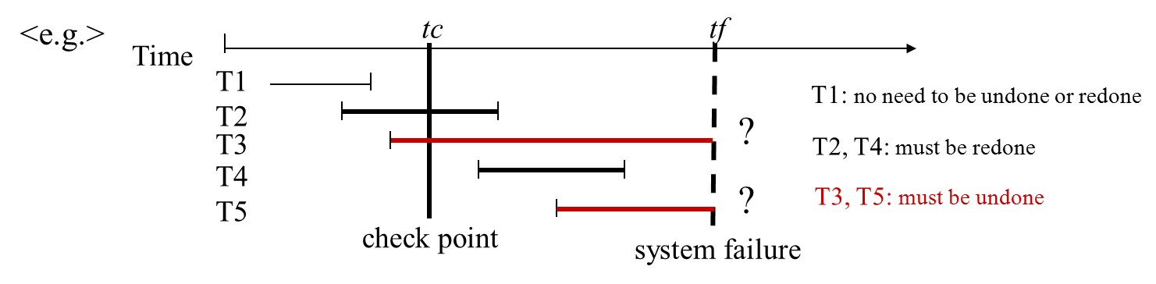
System Failures and Recovery (cont.)
<2> Decide undo and redo list
Decide the undo list and redo list by the following procedure :
STEP1:
UNDO-list = list of transactions given in the checkpoint record = {T2, T3}
REDO-list = { }
STEP2:
Search forward through the log, starting from the checkpoint, to the end of log:
if a 'BEGIN TRANSACTION' is found => add to UNDO-list {T2, T3, T4, T5}
if a 'COMMIT' is found => remove from UNDO-list to REDO-list
UNDO-list = {T3, T5}
REDO-list = {T2, T4}
<3> Undo: System works backward through the log, undoing the UNDO-List.
<4> Redo: System then works forward through the log, redoing the REDO-List
做一半的，要undo
應該已做完，不確定有無 write to disk

Slide 23
Write-Ahead Log Protocol
Write-Ahead Log Protocol (i.e. Log first protocol)
Note: 'write a change to database' and 'write the log record to log' are two distinct operations => failure may occur between them!
Before writing a record to physical database, the log record must first be written to physical log.
Before committing a transaction, all log records must first be written to physical log.
Write
Time
Write Commit log
Write log
Write log
Write db
Write db
log
database
Time
Commit

Slide 24
Write-Ahead Log Protocol (cont.)
Why log need to write ahead? (Think!)
tc
tf
Time
T1
T2
T3
T4
T5
T1: no need to be undone or redone
?
T2, T4: must be redone
T3, T5: must be undone
?
check point
system failure
Case 1
Case 2
Write log
Write Commit log
Write log
Write db
Write db
Time
Commit

Slide 25
12.5 Media Failures and Recovery

Slide 26
Types of Transaction Failure
Type 1 Transaction Failures:
detected by the application program itself.
e.g. Insufficient Funds (balance < 0)
How to handle ?
Issue the ROLLBACK command after the detection. (ref. p.12-7)
Type2 Transaction Failures:
not explicitly handled by the application
e.g. divide by zero, arithmetic overflow, ...
System Failures (Soft crash):
affect all transactions currently in progress,
but do not damage the database. e.g. CPU failure.
Media Failures (Hard crash):
damage the database.
affect all transactions currently using that portion. e.g. disk head crash.
Application program
處理
§ 12.3
§ 12.4
§ 12.5

Slide 27
Media Failures and Recovery
Critical point:
Some portion of the secondary storage is damaged.
How to recover?
(1) load the database to new device from the most recent archive copy (old DB.)
(2) use the log (both active and archive) to redo all the transactions that are completed since that dump was taken.
Note: Assume log dose not fail.
(Duplex log to avoid log failure.)
Old DB
log
New DB
Report

Slide 28
end of unit 12

